Slide 1
AML Account-Level Risk Model
Identifying suspicious accounts from transactional behavior
PEM02
Notes:
Set the frame: this is a technical assessment. Keep it to 20 minutes plus Q&A.

Slide 2
OBJECTIVE
The question
Based only on an account's transaction activity, which accounts are most likely to be suspicious?
FRAMING
Binary classification / risk ranking at the account level
Dataset: IBM AMLSim — 10,000 accounts, 1.3M transactions
Deliverable: a risk score per account, and the reasoning behind it
WHAT "GOOD" MEANS HERE
Not the most complex model — a defensible one. In AML, a score you cannot explain cannot be deployed.

Slide 3
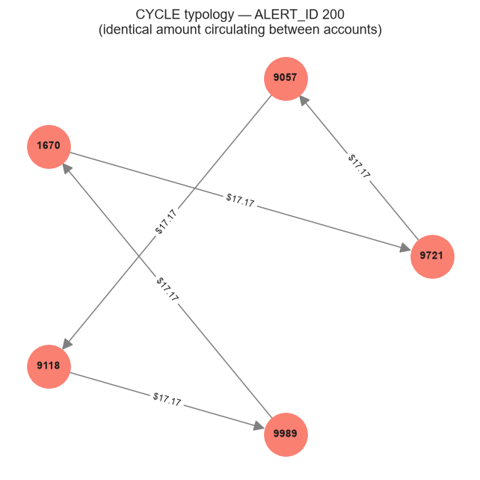
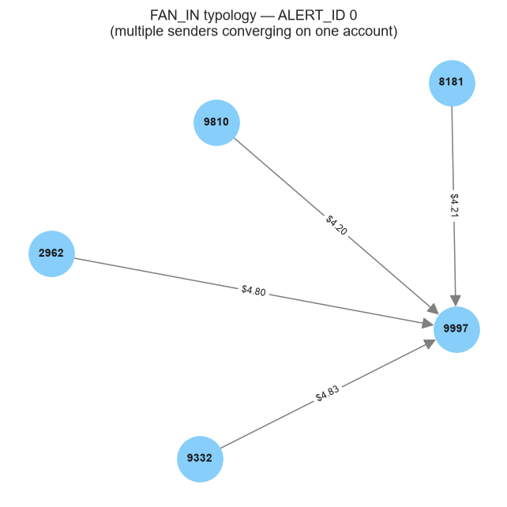
DATA AT A GLANCE
The dataset in six numbers
10,000
TWO TYPOLOGIES, BOTH STRUCTURAL
Accounts
Transactions
1,323,234
Suspicious (SAR) accounts
1,685 · 16.85%
Flagged transactions
1,719 · 0.13%
Laundering schemes
391
Observation window
200 steps
cycle
fan_in
Funds circulate through a chain and return — layering.
Many senders converge on one account — structuring.
Notes:
The two network graphs do more work than any table — the audience sees what the model is looking for. Export from Notebook 1, Sections 6.1 and 6.2.

Slide 4
DATA QUALITY
What we verified
Clean, and verified as such
Target validated in both directions
0 nulls · 0 duplicate keys · 0 orphan IDs · TX_ID sequential and complete
✓ 0 accounts with transactional evidence left unlabeled
46 labeled accounts (2.7%) with no evidence in alerts.csv — a scope limitation of the extract, not label corruption
→ accounts.IS_FRAUD adopted as the target, no redefinition needed.
Notes:
Keep this slide fast — 30 seconds. It establishes the target is trustworthy.

Slide 5
DATA LIMITATIONS · DECLARED UPFRONT
These bound every number that follows
1
16.85% SAR rate — production AML runs below 1%. Our metrics are optimistic.
2
Single channel — transfers only. No cash deposits or withdrawals.
3
Two typologies only — no fan_out, scatter-gather , or stack.
4
Uniform scheme geometry — every cycle is exactly 5 transactions. Reality is not this tidy.
5
Integer overflow defect — 3,053 transactions pinned at exactly 2³¹−1 ÷ 100. A generation bug, not economic behavior.
6
Window censoring — ~5% of schemes truncated at the edges of the observation window.
Notes:
State these BEFORE showing results, not after. It buys credibility for everything that comes next — and pre-empts the expert's first question.

Slide 6
FEATURE ENGINEERING · THE DESIGN PRINCIPLE
The typologies are patterns of structure, not of volume
So, the features answer with whom and how an account transacts — not just how much.
THE DISTINCTION THAT MATTERED MOST
Transactions received
Distinct senders
Account A — 50 tx, all from one counterparty
50
1
Account B — 50 tx, from 50 different counterparties
50
50
Raw counts see these as identical. Account B is a textbook fan_in . Account A is an ordinary supplier relationship.

Slide 7
FEATURE FAMILIES
38 features across 7 families
Network degree
Reciprocity
Flow
Counterparty repetition
Distinct counterparties in / out
Counterparties both sent to and received from
Directional imbalance, pass-through detection
Many senders each contributing little
→ fan_in signature
→ cycle signature
→ layering
→ structuring
Temporal
Volume
Balance-relative
Burstiness — schemes execute fast, not evenly
Baseline context for normalization
Turnover vs. what the account's profile justifies
38
FEATURES TOTAL
→ timing
→ context
→ profile

Slide 8
PREVENTING DATA LEAKAGE
Two channels, closed independently
1. Target-derived columns
2. Statistics on the full dataset
ALERT_ID and transaction-level IS_FRAUD excluded entirely. Only sender, receiver, amount and timestamp were used.
The winsorization threshold (p99) is a learned parameter , like a model coefficient. Computing it over the full dataset would embed test-set information.
CONSEQUENCE — THE SPLIT RUNS BEFORE FEATURE ENGINEERING
→
→
→
Split accounts
Compute p99 on TRAIN only
Apply fixed threshold
Build features
stratified
$1,826,133
to all data
Scaling is fitted inside a Pipeline, sot its re-fits on training folds only during cross-validation.

Slide 9
MODELING APPROACH
Two hypotheses, tested head-to-head
Model 1 — Logistic Regression (baseline)
WHY XGBOOST SPECIFICALLY
Hypothesis: summing independent feature contributions is enough. A linear boundary separates the classes.
·
Captures conditional rules natively (cascading splits)
·
Boosting: each tree corrects the previous one's errors
·
Robust to the heavy tails we found in the data
Model 2 — XGBoost
·
SHAP-explainable
— non-negotiable for SAR filing
Hypothesis: the signal is in conditional combinations.
A fan_in is not "high in-degree." It is high in-degree AND low transactions-per-counterparty AND activity in bursts.
CLASS IMBALANCE
class_weight='balanced' / scale_pos_weight.

Slide 10
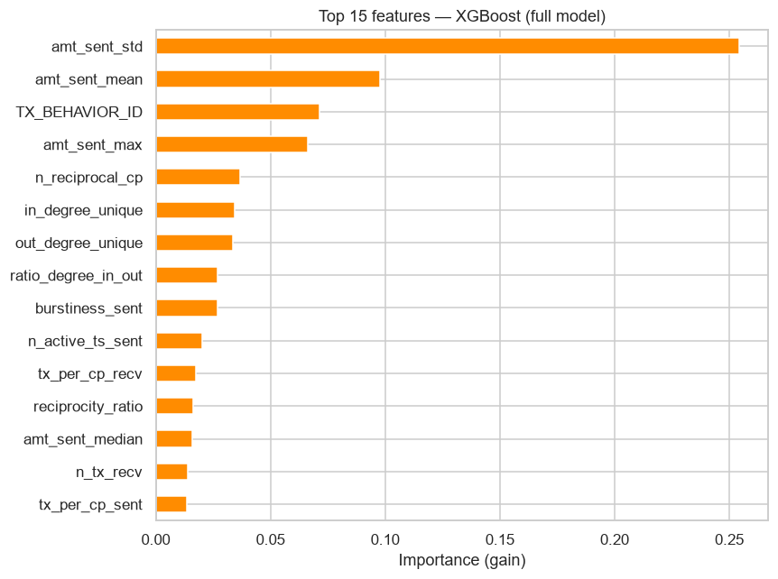
FIRST RESULTS … AND A RED FLAG
Two things did not add up
Model
ROC-AUC
PR-AUC
Logistic Regression
0.869
0.719
XGBoost
0.967
0.932
1
We had established beforehand: no feature exceeds 0.30 univariate correlation, and the classes overlap heavily. A 0.97 ROC-AUC was not what this data should produce.
2
The top feature was amt_sent_std — the standard deviation of amounts sent. No AML typology predicts that amount dispersion is the primary risk signal.
When a model leans on a variable with no basis in the domain, the likely explanation is not insight. It is a shortcut.

Slide 11
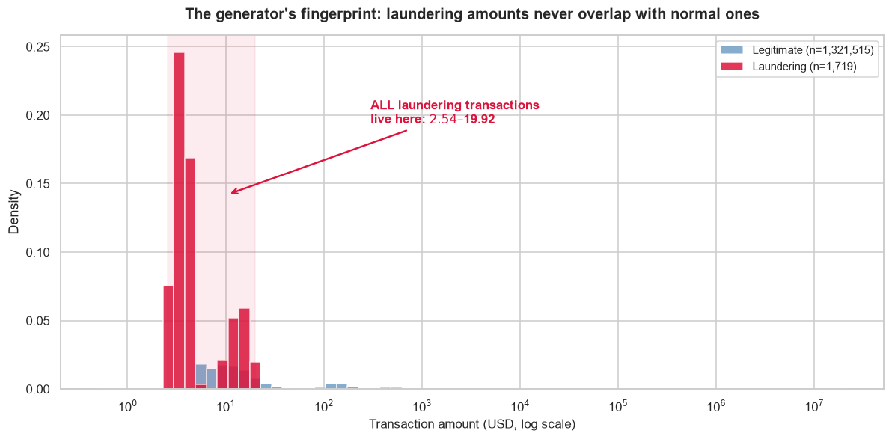
THE AUDIT ★
The amount features were detecting the simulator
Hypothesis: the generator injects laundering transactions with distinctively tiny amounts. Any account in a scheme carries that fingerprint.
MEDIAN MINIMUM AMOUNT SENT
Legitimate accounts
Fraudulent accounts
$267.95
$10.60
A RULE WITH NO MODEL AT ALL
"Flag any account that sent a transaction below $20." → 90% recall.
They were not detecting money laundering. They were detecting Dataset generation.
Notes:
This is the slide that wins the room. Slow down here. Walk them from the hypothesis to the $20 rule to the punchline.

Slide 12
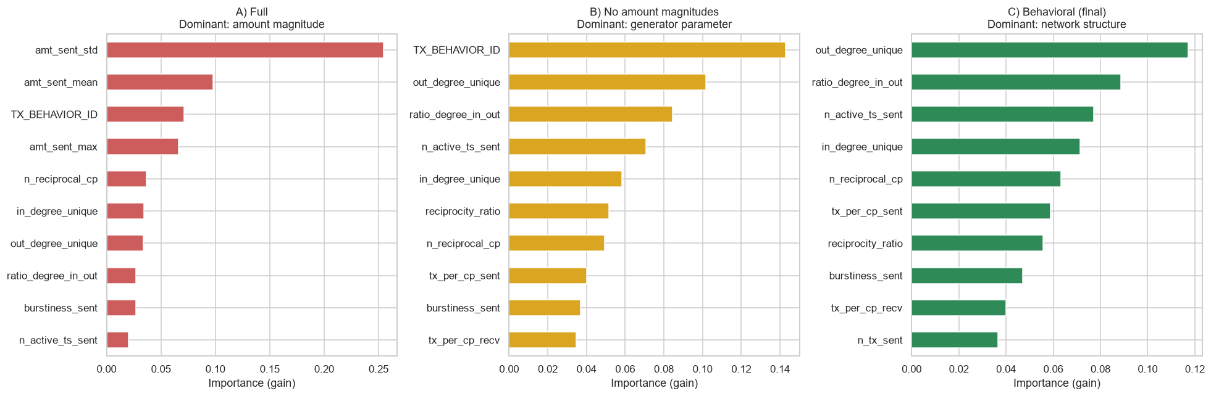
ABLATION ★
Remove the first shortcut, and the model reaches for a second
Variant
ROC-AUC
Top feature
Nature
A) Full
0.967
amt_sent_std
Generator artifact
B) No amounts
0.943
TX_BEHAVIOR_ID
Generator parameter
C) Behavioral
0.943
out_degree_unique
Network structure ✓
TX_BEHAVIOR_ID is not an observation of behavior — it is the parameter AMLSim used to generate that behavior. Removing it cost nothing (0.943 vs 0.943): its signal was dominant but redundant .
Only variant C answers the question asked: "based only on the account's transaction activity."

Slide 13
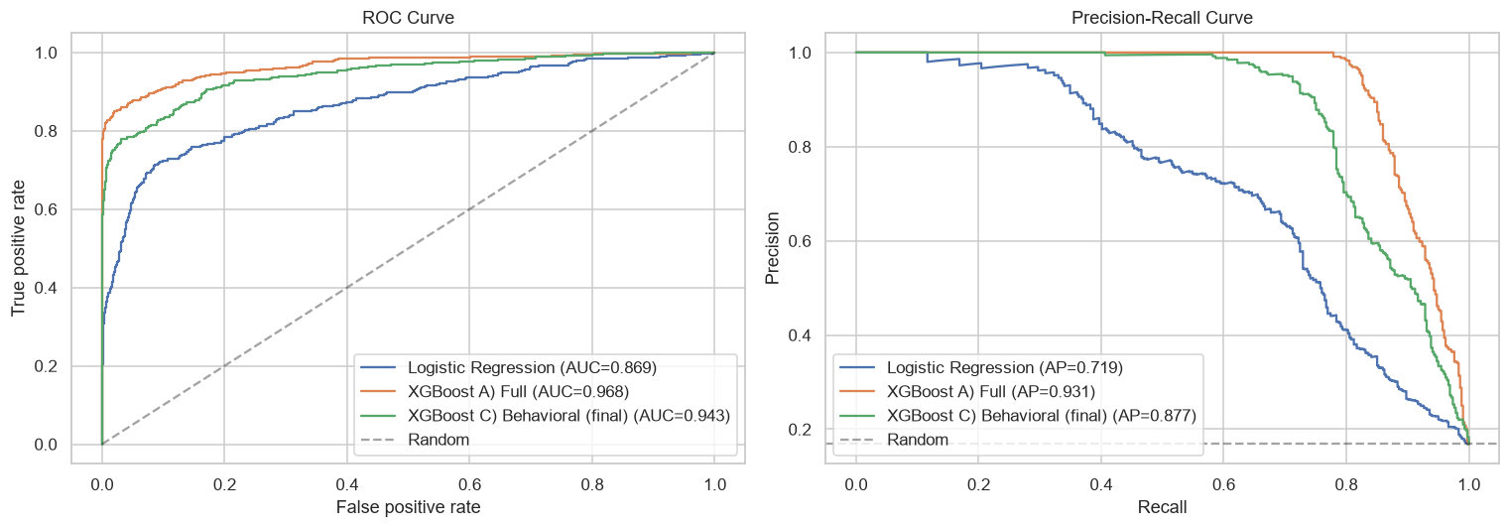
FINAL RESULTS
XGBoost beats logistic regression decisively
Model
ROC-AUC
PR-AUC
Prec.
Recall
Logistic Regression
0.869
0.719
0.561
0.729
XGBoost — behavioral (final)
0.943
0.883
0.858
0.776
Random baseline
0.500
0.168
—
—
Confirms the hypothesis: the classes are not linearly separable. The signal lives in combinations.
METRIC PRIORITY: PR-AUC, NOT ROC-AUC
ROC-AUC counts true negatives — and in production >99% of accounts are legitimate. It stays high while analysts drown in false positives. PR-AUC ignores true negatives entirely.
Precision-Recall curve — it shows the real gap between models

Slide 14
WHAT THIS MEANS OPERATIONALLY ★
The metric that governs an AML system: Precision@K and Recall@K
Not "what threshold?" — "how many accounts can my team investigate today?"
Team capacity
SAR captured
Precision
Recall
Reviewing 250 accounts at random finds 42 real cases. Reviewing the model's top 250 finds 247.
Top 5% · 125 accounts
125 / 421
100%
29.7%
Top 10% · 250 accounts
247 / 421
98.8%
58.7%
5.9×
Top 20% · 500 accounts
347 / 421
69.4%
82.4%
the cases · same effort
Top 30% · 750 accounts
381 / 421
50.8%
90.5%
The model does not make the trade-off — it exposes the frontier. The compliance lead chooses.
Notes:
The numbers are the slide. Let them breathe. The 5.9× comparison is the takeaway — say it plainly.

Slide 15
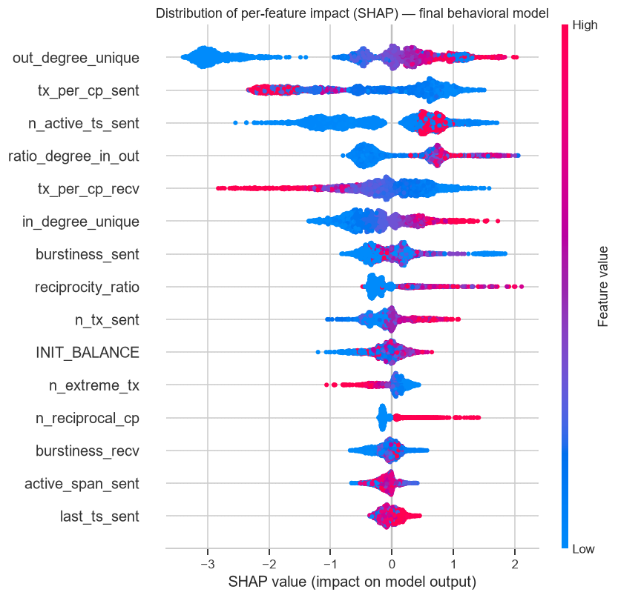
WHAT THE MODEL LEARNED
Every top feature is structural — none are amounts
out_degree_unique / in_degree_unique — convergence of distinct counterparties = fan_in
ratio_degree_in_out — receives from many, sends to few
n_reciprocal_cp — bidirectional counterparties = cycle
burstiness_sent — schemes execute in bursts, not evenly
tx_per_cp_sent — inverse : repeating with one counterparty lowers risk; spreading across many raises it = structuring
A confirmation: the model discarded n_extreme_tx — the overflow-affected feature we had flagged as mechanically correlated. It agreed with us.
SHAP beeswarm — global feature attribution

Slide 16
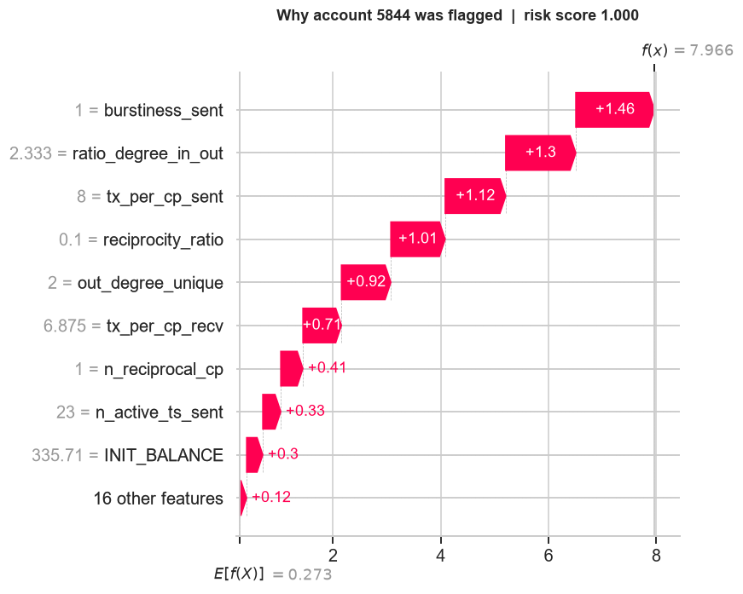
EXPLAINING A SINGLE DECISION
A score alone is not a SAR narrative
Account 5844
risk 0.9997
true label: SUSPICIOUS
Factor
Value
SHAP
All activity in a single timestep
burstiness = 1.00
+1.40
Receives from 2.3× more counterparties than it sends to
ratio = 2.33
+1.33
Maintains bidirectional counterparties
reciprocity = 0.10
+0.88
"This account was flagged because it concentrated its entire activity into one timestep, receives from disproportionately many distinct counterparties, and maintains circular relationships."
That is a SAR narrative. A score alone is not.
SHAP waterfall — account 5844

Slide 17
LIMITATIONS AND NEXT STEPS
What we carry forward, and where it goes next
LIMITATIONS WE CARRY FORWARD
NEXT STEPS, IN PRIORITY ORDER
·
Metrics are optimistic: 16.85% prevalence vs <1% in production
1
Re-validate at realistic prevalence — downsample positives to ~1%. The test that matters.
2
Second-order graph features — PageRank, betweenness, community detection.
·
Two typologies only — no guarantee of generalization
·
Single channel — no cash
3
Graph Neural Networks — learn from topology directly, not a tabular translation.
4
Calibrate K to capacity — optimize for Precision@K, not a global metric.
·
Decision threshold not yet calibrated to team capacity
5
Temporal split + drift monitoring — replicate deployment; retrain on schedule.
6
LLM-assisted SAR narratives — turn SHAP output into analyst-ready text.

Slide 18
CLOSING
Three things I would want you to take away
1
The features that worked were the ones built from the structure of the crime — network degree, reciprocity, burstiness. Not volume. Not amounts.
2
The model's best score was its least trustworthy one. 0.967 was a shortcut. 0.943 is real.
3
A model you cannot explain cannot be deployed in AML. SHAP is not a nice-to-have — it is the SAR.
Notes:
Land the three takeaways slowly. These are the sentences you want them repeating after you leave the room.

Slide 19
APPENDIX
Backup slides

Slide 20
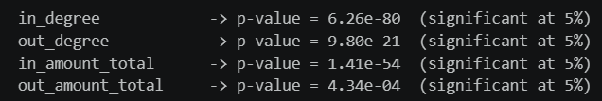
BACKUP · B1
Univariate signal check
Mann-Whitney U (non-parametric — the variables are heavy-tailed, so a t-test would be invalid):
Variable
p-value
All significant. Inbound flow dominates outbound — consistent with fan_in concentrating anomaly on the receiver.
in_degree
6.26e-80
But: significance ≠ effect size. Max correlation was 0.30. This is why we expected XGBoost to win.
in_amount_total
1.41e-54
out_degree
9.80e-21
out_amount_total
4.34e-04

Slide 21
BACKUP · B2
Why not SMOTE
Synthesizing accounts by interpolating network features produces structurally impossible records — e.g. a reciprocity_ratio incompatible with the interpolated in_degree.
Class weighting achieves the same goal without fabricating data.

Slide 22
BACKUP · B3
Why not Random Forest / LightGBM
Random Forest
LightGBM
Valid, simpler. Bagging averages independent strong trees; boosting chains weak learners that correct each other — better at the subtle interactions this problem needs.
Its edge is speed at scale. At 10,000 rows, both train in seconds.

Slide 23
BACKUP · B4
Cross-validation
5-fold stratified CV on train, PR-AUC.
Consistent with holdout → performance is not a lucky partition.

Slide 24
BACKUP · B5
Data dictionary
Full column-by-column breakdown of the three files, with observed relationships.
→ Notebook 1, Section 2.1.

Slide 25
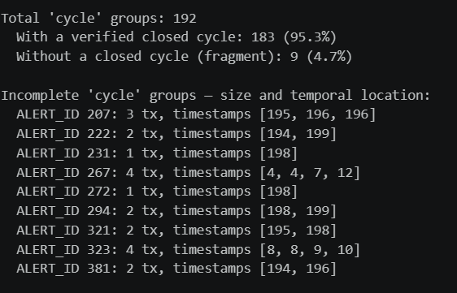
BACKUP · B6
Window censoring
183 / 192 cycle groups form a verified closed cycle. The 9 that do not are fragments at timesteps 194–199 or 4–12 — the edges of the observation window.
Not a labeling error: schemes truncated by the capture period. The same occurs in any finite production window.

